Slide 1

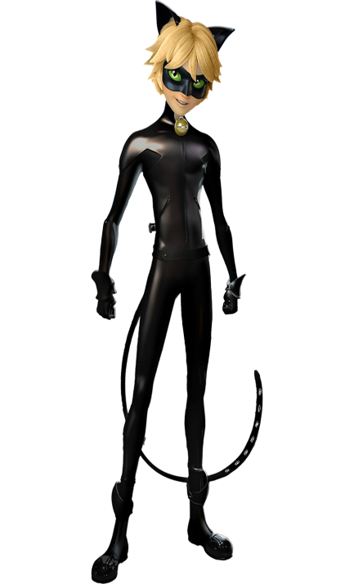
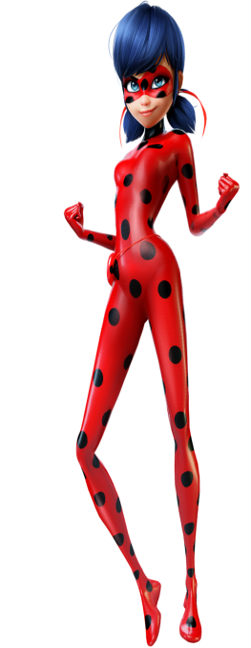

The
Miraculous
rush

Slide 2
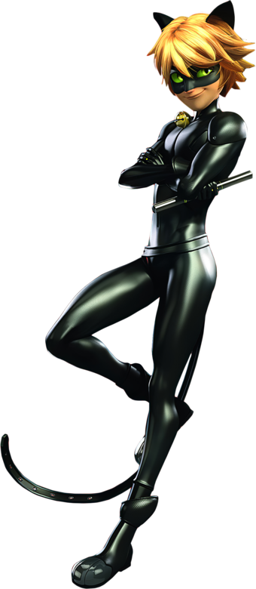
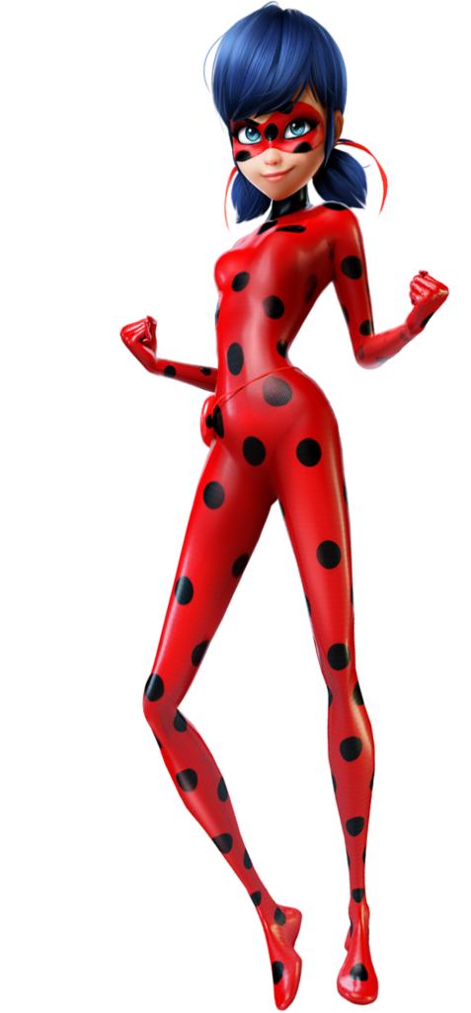
Choose your character
The
Miraculous
rush
Cat noir
Ladybug

Slide 3
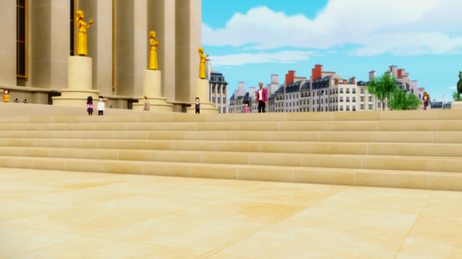



Deaths: 1 Life: 3 Power Ups: 2

Slide 4
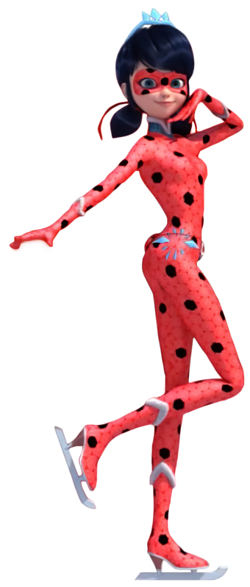

Deaths: 1 Life: 3 Power Ups: 2

Slide 5
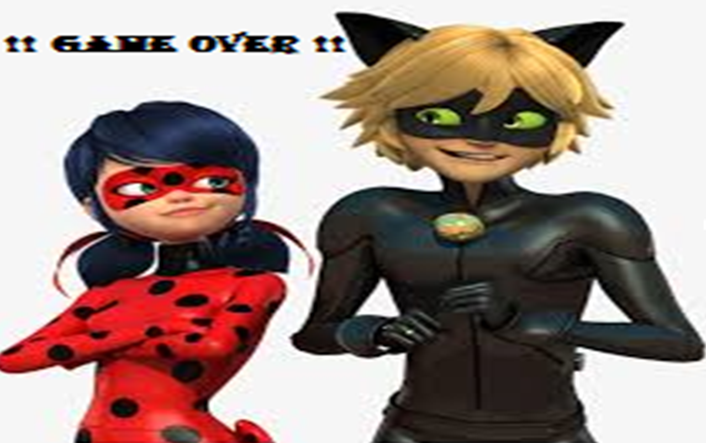
Press space for restarting the game

